Slide 1
PARALEGAL STUDENTS’ AND PARALEGAL INSTRUCTORS’ PERCEPTIONS OF SYNCHRONOUS AND ASYNCHRONOUS ONLINE PARALEGAL COURSE EFFECTIVENESS: A COMPARATIVE STUDY
Dissertation defense
s. Kristine farmer
June 11, 2018
COMMITTEE:
JEFF M. ALLEN, MAJOR PROFESSOR
KAREN JOHNSON, CO-MAJOR PROFESSOR
PETER JOHNSTONE, MINOR PROFESSOR

Slide 2
OVERVIEW
Part I: Why?
  Research Problem
  Theoretical Framework
  Purpose of the Study
  Literature Review
Part II: How, When, Who?
  Research Questions
  Data Collection: Procedures & Participants
  Statistical Analyses
Part II: What (It Means)?
  Summary of Findings & Discussion
  Limitations
  Practical Application
  Future Research
  Potential Publication Sources

Slide 3
RESEARCH PROBLEM
Paralegal profession originated in the 1960s (McCabe, 2007)
Despite the longevity and continued growth of the paralegal profession, there is a dearth of empirical literature related to paralegals generally, and to paralegal education, specifically.
American Bar Association Guidelines provide that all ABA-approved paralegal programs must require students to take 10 semester credit hours of legal specialty courses in the traditional, face-to-face format.
Growth of online enrollment in the United States now surpasses traditional, face-to-face enrollment (Rich & Dereshiwsky, 2011); The fast growth of online learning has surpassed our knowledge of it, thus there is a paucity of empirical research examining the world of synchronous learning (Shi, Bonk, Tan, & Mirshra, 2008).
90.3% of institutions agree that online education is part of their long-term strategy (Allen & Seaman, 2014).
Learning effectiveness generally “fall[s] into three broad categories:
    Students’ outcomes, focused on test scores and grades;
    Student attitudes about learning; and
    Overall student satisfaction with online learning” (Robinson & Hullinger, 2008, p. 101).
Few studies have evaluated faculty and student perceptions of effectiveness online courses.
pp. 11-15

Slide 4
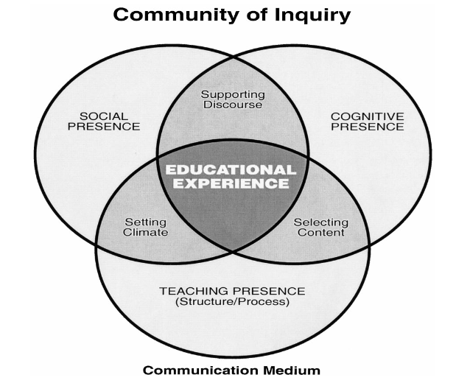
THEORETICAL FRAMEWORK
Constructivist theory
  Developed by Dewey (1916), Piaget (1973), and Vygotsky (1978);
  Can be used as a framework to support the use of online synchronous instruction (Almala, 2006; Fox, 2001; Gordon, 2008; Knowlton, 2000).
  Presumes learner constructs knowledge of a subject through a formative process.
Community of Inquiry (CoI) framework
  Collaborative constructivist model that deems online courses as successful when students engage both in a collaborative and individual “search for meaning and understanding” (Akyol, Garrison, & Ozden, 2009, p. 6; Garrison, Anderson, & Archer, 2000).
  Taking both the instructor and the students together, they form a community of online learning encompassing three elements: cognitive presence, social presence, and teaching presence (see Fig. 1).
pp. 15-18

Slide 5
PURPOSE OF THE STUDY
Measured the perceptions of paralegal students and paralegal instructors toward the effectiveness of synchronous and asynchronous online paralegal courses.
11 dependent variables for course effectiveness subscales:
  flexibility, user interface, navigation, getting started, technical assistance, course management (instructor), course management (student), universal design, communication, instructional design, and content
Independent variables of:
  Gender, age, native language, educational level, technology skills, and synchronous/asynchronous course experience
Anticipated the findings of this study may be used to inform paralegal instructors and course developers gain better understanding of how to design, deliver, and evaluate effective online course instruction in the field of paralegal studies.
pp. 19-20

Slide 6
RESEARCH QUESTIONS
R₁: Were there significant differences between paralegal students’ perceptions and paralegal instructors’ perceptions of synchronous online paralegal course effectiveness?
R₂: Were there significant differences between paralegal students’ perceptions and paralegal instructors’ perceptions of asynchronous online paralegal course effectiveness?
R₃: Were there significant differences in paralegal students’ perceptions course effectiveness between synchronous online paralegal courses and asynchronous online paralegal courses?
R₄: Were there significant differences in paralegal instructors’ perceptions course effectiveness between synchronous online paralegal courses and asynchronous online paralegal courses?
pp. 20-21

Slide 7
RESEARCH QUESTIONS (cont.)
R₅: Were there significant relationships between paralegal students’ perceptions of synchronous online paralegal course effectiveness subscales and students’ demographic characteristics?
R₆: Were there significant relationships between paralegal students’ perceptions of asynchronous online paralegal course effectiveness subscales and students’ demographic characteristics?
R₇: Were there significant relationships between paralegal instructors’ perceptions of synchronous online paralegal course effectiveness subscales and instructors’ demographic characteristics?
R₈: Were there significant relationships between paralegal instructors’ perceptions of asynchronous paralegal course effectiveness subscales and instructors’ demographic characteristics?
pp. 20-21

Slide 8
LITERATURE REVIEW—STUDENT PERCEPTIONS
Colorado & Eberle (2010). Age has been found to have no significant affect on academic performance in online courses across disciplines, F(2, 167) = 1.46, p = .235.
Tung (2007). A study of community college students revealed no statistically significant difference in student perceptions of course effectiveness across students’ gender, and further, found no statistically significant relationship between students’ age and course effectiveness. Paralegal instructors’ perceptions were higher than paralegal students’ regarding effective synchronous online course instructional design and content.
Yang & Cornelius (2004). Students’ positive perceptions of the quality of online courses include flexibility, cost-effectiveness, and ease of internet connection to be positive online course effectiveness; Negative perceptions include an instructor’s lack of technical support, tedious and uninteresting instructional methods as well as poorly designed course content.
pp. 24-32

Slide 9
LITERATURE REVIEW—INSTRUCTOR PERCEPTIONS
Cherry & Flora (2017). The relationship of faculty perceptions of course effectiveness to years of teaching online courses was found to be statistically significant: perception of course effectiveness increasing both with the increased number of years teaching online courses, (r(214) = .209, p = .002) and with the increased number of online courses taught (r(213) = .282, p < .001). Similarly, faculty perceptions of online course effectiveness were not found to be significantly affected by faculty age (r(213) = —.013, p = .854).
Seok, Kinsell, DaCosta, & Tung (2010). Similar to students’ perceptions, positive perceptions of the quality of online courses include flexibility, user interface, navigation, course management, technical support, universal design, and course content.
pp. 24-32

Slide 10
POPULATION DESCRIPTION
The targeted population of the study was paralegal students and paralegal instructors enrolled in / taught synchronous or asynchronous online paralegal courses in the United States
  Paralegal Students:
    Approximately 9,600 students earned bachelor’s degrees, master’s degrees, or post-baccalaureate certificates in paralegal studies across the United States from July 1, 2015 to June 30, 2016 (National Center for Education Statistics, 2017).
    Approximately one-third of these paralegal students (X ≈ 3,200) were enrolled in a synchronous or asynchronous online paralegal course at some time during their paralegal studies (Allen & Seaman, 2016).
  Paralegal Instructors:
    674 paralegal programs that awarded bachelor’s degrees, master’s degrees, or post-baccalaureate certificates in paralegal studies across the United States from July 1, 2015 to June 30, 2016 (National Center for Education Statistics, 2017).
    On average, there are between one to five instructors teaching within those paralegal programs, which equates to approximately 1,700 full-time and adjunct paralegal instructors.
    Approximately one-third of these paralegal instructors (X ≈ 570) have taught a synchronous or asynchronous online paralegal course at some time during their teaching tenure (AAfPE, 2017).
pp. 35-36

Slide 11
SURVEY DESIGN
Two validated survey questionnaires used in the Tung (2007) study with two sections:
    Perceptions of course effectiveness
          99 questions for each identical survey
          Used a five-point Likert-type scale:
              "1 = strongly disagree," "2 = disagree," "3 = neutral," "4 = agree," and "5 = strongly agree.”
    Personal data
            Student’s / Instructor’s gender, year of birth, state/location of paralegal courses, native language, paralegal education level, general education level, technology skills, synchronous online paralegal courses taken / taught, and asynchronous online paralegal courses taken / taught
Flexibility – Questions 1-6
User Interface – Questions 7-15
Navigation – Questions 16-21
Getting Started – Questions 22-27
Technical Assistance – Questions 28-31
Course Management (instructor) – Questions 32-41
Course Management (student) – Questions 42-48
Universal Design – Questions 49-55
Communications – Questions 56-63
Online Instructional Design – Questions 64-85
Content – Questions 86-99
pp. 38-40

Slide 12
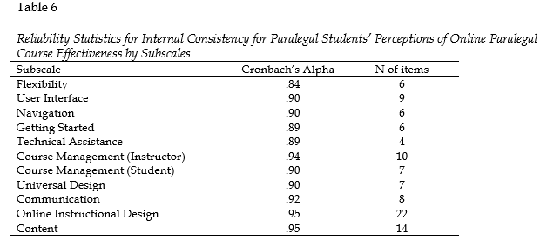
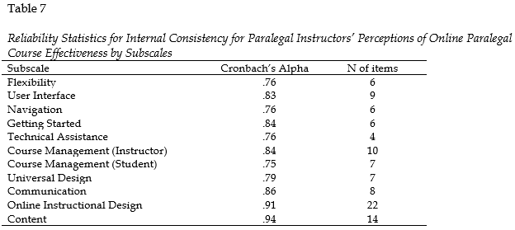
INSTRUMENT ANALYSIS
Analysis showed acceptable reliability as measured by Cronbach’s alpha:
pp. 52-54

Slide 13
DATA COLLECTION
Two Phases (February 22, 2018 to April 22, 2018):
  Phase I - Data collection from paralegal instructors – invited to participate by:
    AAfPE members’ only listserv;
    AAfPE LinkedIn and Facebook Groups; and
    Individual emails to paralegal program directors and instructors.
  Phase II - Data collection from paralegal students – invited to participate by:
    Paralegal instructors either by email or by posting survey link in an announcement in their online classroom.
Utilized UNT’s Qualtrics Survey Software
Individuals were incentivized to respond to the survey through the random selection of 10 students and 10 instructors receiving $15 iTunes/Google Play and Amazon gift cards, respectively
Reminders were sent in Phase I the following Sunday, at approximately 2:00 p.m. A notice was sent on the Friday before the final date of participation at approximately 3:00 p.m.
pp. 40-43

Slide 14
SAMPLE OVERVIEW & DEMOGRAPHICS
Paralegal students
Paralegal instructors
  89 Students
    78% female | 22% male
    92% native English speakers
    Technology Skills
      Advanced: 69%
      Intermediate: 30%
      Beginner: 1%
    Generational cohorts:
      Baby Boomer: 6%
      Gen X: 15%
      Millennials: 58%
      Gen Z: 22%
  67 Instructors
    73% female | 27% male
    100% native English speakers
    Technology Skills
      Advanced: 79%
      Intermediate: 21%
      Beginner: None
    Generational cohorts:
      Baby Boomer: 56%
      Gen X: 38%
      Millennials: 6%
      Gen Z: None
pp. 47-50

Slide 15
RESEARCH DESIGN
Attempted to draw conclusions about two populations using samples drawn from two specific populations using quantitative research methodologies (Gall, Borg, & Gall, 1996).
Independent samples t-test: testing the differences in perceptions.
Correlational analysis: testing the relationship between paralegal instructors’ perceptions | paralegal students’ perceptions and demographics.
Descriptive statistics.
pp. 33-34

Slide 16
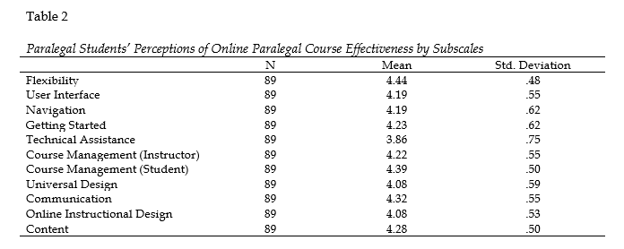
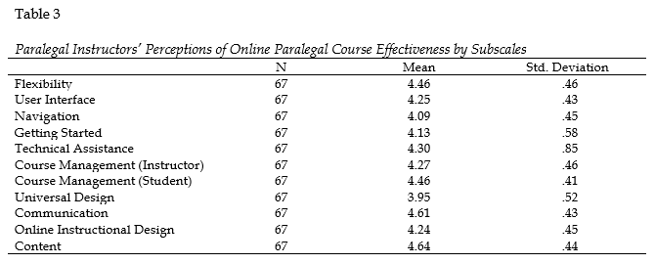
SUMMARY OF FINDINGS
The results indicated that overall, paralegal students and paralegal instructors positively perceived synchronous and asynchronous online paralegal course effectiveness.
pp. 49-50

Slide 17
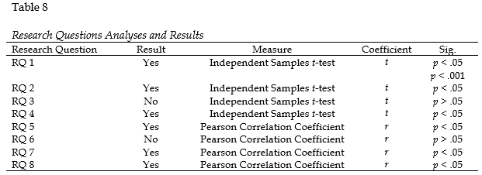
SUMMARY OF FINDINGS & DISCUSSION
p. 54

Slide 18
SUMMARY OF FINDINGS
R₁: Were there significant differences between paralegal students’ perceptions and paralegal instructors’ perceptions of synchronous online paralegal course effectiveness?
Results: Paralegal instructors reported higher perceptions of online course instructional design and course content in synchronous online courses than paralegal students.
R₂: Were there significant differences between paralegal students’ perceptions and paralegal instructors’ perceptions of asynchronous online paralegal course effectiveness?
Results: Paralegal instructors reported higher perceptions of effectiveness of technical assistance, communication, and course content in asynchronous online courses. Paralegal students reported higher perceptions of universal design.
R₃: Were there significant differences in paralegal students’ perceptions course effectiveness between synchronous online paralegal courses and asynchronous online paralegal courses?
Results: No statistically significant differences.
R₄: Were there significant differences in paralegal instructors’ perceptions course effectiveness between synchronous online paralegal courses and asynchronous online paralegal courses?
Results: Paralegal instructors reporter higher perceptions of effectiveness of universal design, online instructional design, and course content in synchronous courses than asynchronous courses.
pp. 55-61

Slide 19
SUMMARY OF FINDINGS (cont.)
R₅: Were there significant relationships between paralegal students’ perceptions of synchronous online paralegal course effectiveness subscales and students’ demographic characteristics?
Results: Strong, negative relationships between paralegal students’ age and paralegal students’ perceptions of effective synchronous paralegal course user interface, navigation, universal design, and online instructional design.
R₆: Were there significant relationships between paralegal students’ perceptions of asynchronous online paralegal course effectiveness subscales and students’ demographic characteristics?
Results: No statistically significant relationships.
R₇: Were there significant relationships between paralegal instructors’ perceptions of synchronous online paralegal course effectiveness subscales and instructors’ demographic characteristics?
Results: Strong, negative relationship between paralegal instructors’ age and synchronous online course content;
Strong positive relationship between paralegal instructors’ education level and synchronous online course content; and
Strong, positive relationships between the number of synchronous courses taught by paralegal instructors’ and their perceptions of effective synchronous online user interface, technical assistance, course management (student), and instructional design.
R₈: Were there significant relationships between paralegal instructors’ perceptions of asynchronous paralegal course effectiveness subscales and instructors’ demographic characteristics?
Results: Negative relationship between paralegal instructors’ age and their perceptions of effective asynchronous online getting started; positive relationship between paralegal instructors’ technology skills and asynchronous universal design.
pp. 61-68

Slide 20
LIMITATIONS
Generalizability of this study was affected by:
    Response rate
        Minimum sample size needed to achieve statistical significance; small sample
    Self-reporting questionnaire; response biases
    Variation of each participant’s definition of the Likert scale, or lack of granularity in those scales
pp. 81-82

Slide 21
PRACTICAL APPLICATION
Paralegal profession should embrace the advances in technology and the results of this study and consider eliminating any requirement for traditional face-to-face paralegal courses: allowing synchronous online courses to serve as valid, acceptable alternative.
Paralegal instructors should be provided professional development training to bolster their abilities to create effective synchronous and asynchronous online paralegal courses: understand differences in perceptions of course effectiveness between students and instructors.
Online classroom mimics virtual/remote teams often found in law firms, corporations, and other employers of paralegals: integrate innovation and technology into their online courses and assignments.
Paralegal students desire more effective communication: timely and constructive feedback; incorporate synchronous aspects of online communication in asynchronous classroom.
Online paralegal courses should include substantive, meaningful, and timely course content directly influences how paralegal student perceive online course effectiveness.
Strong, negative relationship between paralegal students’ age and their perceptions of effective synchronous online course design, universal design, navigation, and user interface; not being designed to meet the needs of Millennials and Gen Z; paralegal instructors are predominantly Baby Boomers and Gen Xers; engage Millennial and Gen Z students through use of technology in meaningful ways to better engage them.
pp. 82-86

Slide 22
FUTURE RESEARCH
Research in the Field of Paralegal Studies
  Explore broader topics of assessing satisfaction and success of both synchronous and asynchronous online paralegal course environments and its intersection with paralegal students’ and instructors’ demographic characteristics.
  Examine the roles that technology and instructor innovation play in online paralegal courses, especially through the lens of student success, satisfaction, and performance.
  Explore the effects of students’ critical thinking skills, knowledge construction, time management, and student expectations of course effectiveness and efficiency as they relate to the quality and effectiveness of the online learning environment.
  Investigate student performance in the online classroom across varying types of assignment and assess learning at different times throughout the course and in different modes of instruction.
  Examine differences in online learning outcomes of paralegal courses between the generational cohorts of Baby Boomers, Gen X, Millennials, and Gen Z, especially as related to the generational cohorts of paralegal instructors.
  Compare and assess the online paralegal course offerings in other countries of common law, such as the ILEX program in England and Wales, to the paralegal programs in the U.S., including online course effectiveness, student and instructor satisfaction, student success, and student learning.
pp. 86-88

Slide 23
FUTURE RESEARCH
Research design:
  Synchronous online paralegal courses are in their infancy. As more paralegal programs begin to offer synchronous and asynchronous, estimated number of instructors will increase, leading to an increase sample size by group.
  Conduct similar study using qualitative methods to gain a deeper understanding of paralegal students’ and paralegal instructors’ perceptions of online learning.
  Use longitudinal research design to examine paralegal students’ perceptions at conclusion of first online paralegal course, conclusion of last online paralegal course, between 3 and 6 months after graduation, and 3 and 6 months after their employment as a paralegal.
Instrumentation:
  Use alternative means for response rating, such as numeric sliding scale, which may allow for a finding of statistical and practical significance between the dependent and independent variables.
pp. 88-90

Slide 24
POTENTIAL PUBLICATION SOURCES
The Internet and Higher Education
Journal of Career and Technical Education
American Journal of Distance Education
Academy of Educational Leadership Journal
p. 21

Slide 25


PARALEGAL INSTRUCTORS’ AND PARALEGAL STUDENTS’ PERCEPTIONS OF SYNCHRONOUS AND ASYNCHRONOUS ONLINE PARALEGAL COURSE EFFECTIVENESS:
A COMPARATIVE STUDY
S. Kristine Farmer, B.B.A., M.S.
Dissertation Defense
Dr. Jeff Allen, Major Professor
Dr. Karen Johnson, Co-Major Professor
Dr. Peter Johnstone, Minor Professor
June 11, 2018

Slide 26
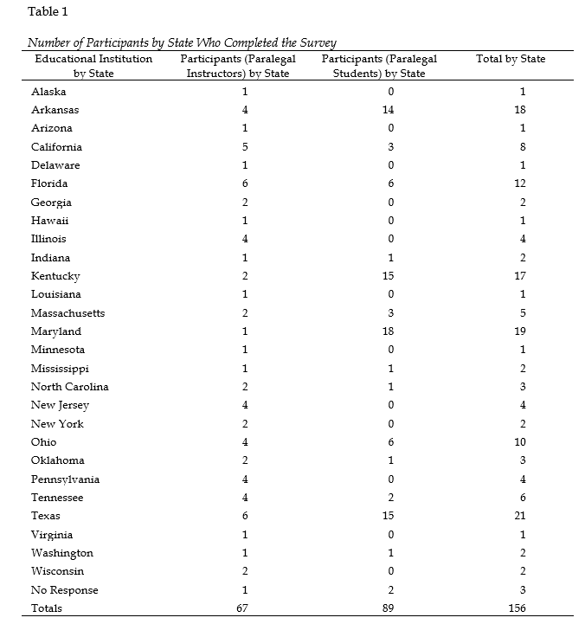
SAMPLE OVERVIEW & DEMOGRAPHICS
p. 48

Slide 27
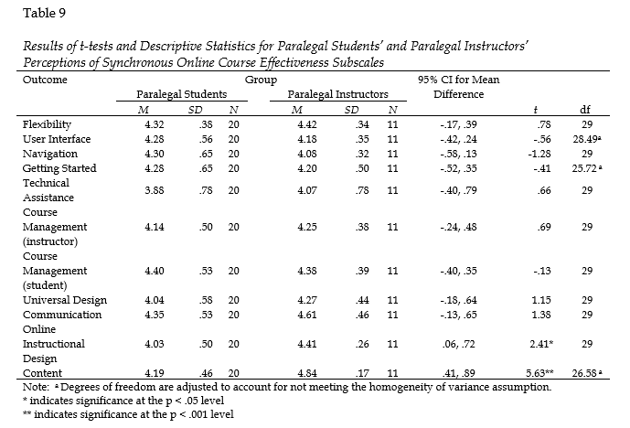
R₁: Are there significant differences between paralegal students’ perceptions and paralegal instructors’ perceptions of synchronous online paralegal course effectiveness?
Results: Paralegal instructors reported higher perceptions of online course instructional design and course content in synchronous online courses than paralegal students.
pp. 55-56

Slide 28
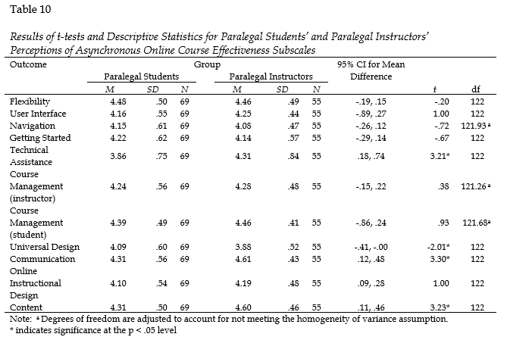
R₂: Are there significant differences between paralegal students’ perceptions and paralegal instructors’ perceptions of asynchronous online paralegal course effectiveness?
Results: Paralegal instructors reported higher perceptions of effectiveness of technical assistance, communication, and course content in asynchronous online courses. Paralegal students reported higher perceptions of universal design.
pp. 56-57

Slide 29
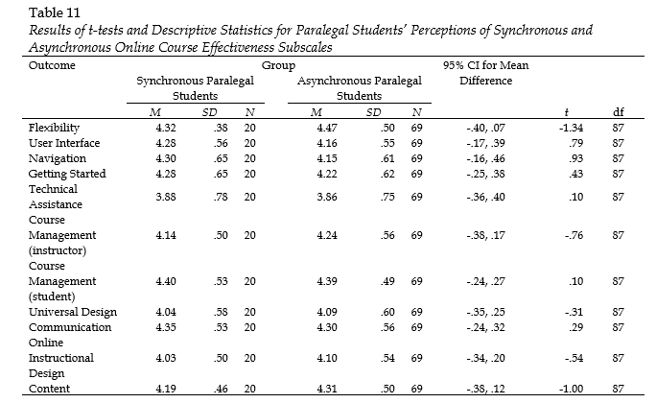
R₃: Are there significant differences in paralegal students’ perceptions course effectiveness between synchronous online paralegal courses and asynchronous online paralegal courses?
Results: No statistically significant differences.
pp. 58-59

Slide 30
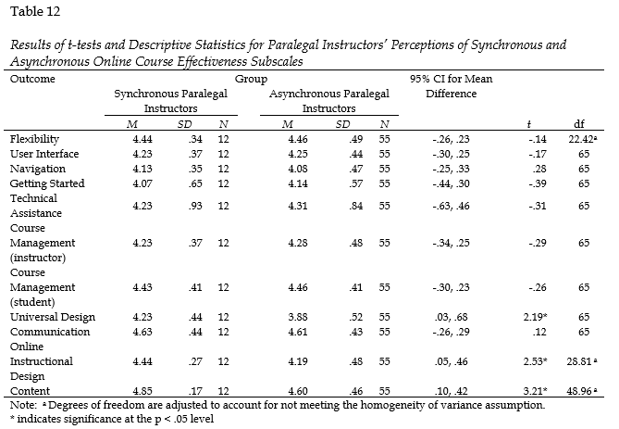
R₄: Are there significant differences in paralegal instructors’ perceptions course effectiveness between synchronous online paralegal courses and asynchronous online paralegal courses?
Results: Paralegal instructors reporter higher perceptions of effectiveness of universal design, online instructional design, and course content in synchronous courses than asynchronous courses.
pp. 59-61

Slide 31
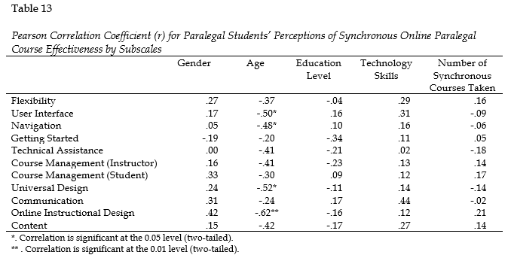
R₅: Are there significant relationships between paralegal students’ perceptions of synchronous online paralegal course effectiveness subscales and students’ demographic characteristics?
Results: Strong, negative relationships between paralegal students’ age and paralegal students’ perceptions of effective synchronous paralegal course user interface, navigation, universal design, and online instructional design.
pp. 61-63

Slide 32
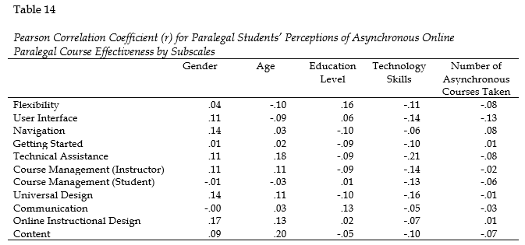
R₆: Are there significant relationships between paralegal students’ perceptions of asynchronous online paralegal course effectiveness subscales and students’ demographic characteristics?
Results: No statistically significant relationships.
pp. 63-64

Slide 33
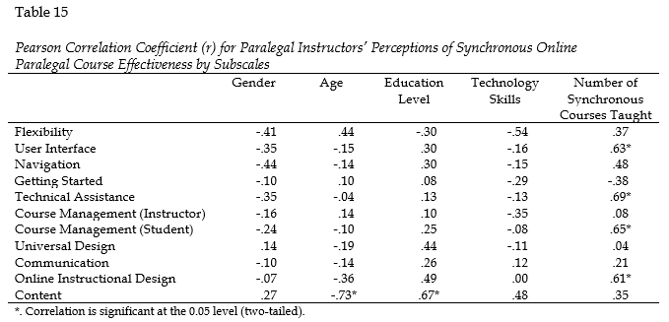
R₇: Are there significant relationships between paralegal instructors’ perceptions of synchronous online paralegal course effectiveness subscales and instructors’ demographic characteristics?
Results: Strong, negative relationship between paralegal instructors’ age and synchronous online course content;
Strong positive relationship between paralegal instructors’ education level and content; and
Strong, positive relationships between the number of synchronous courses taught by paralegal instructors’ and their perceptions of effective synchronous online user interface, technical assistance, course management (student), and instructional design.
pp. 64-66

Slide 34
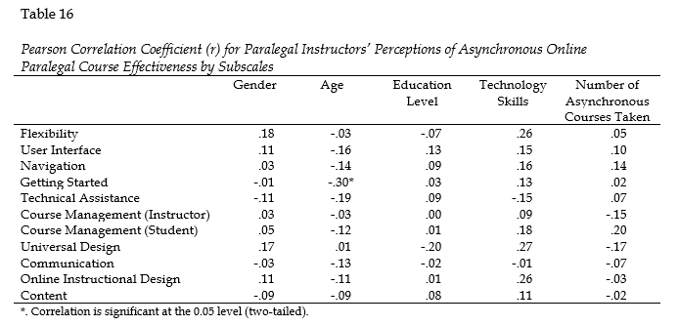
R₈: Are there significant relationships between paralegal instructors’ perceptions of asynchronous paralegal course effectiveness subscales and instructors’ demographic characteristics?
Results: Negative relationship between paralegal instructors’ age and their perceptions of effective asynchronous online getting started; positive relationship between paralegal instructors’ technology skills and asynchronous universal design.
pp. 66-67

